Slide 1
Smart Knee
Brace
Low Wai Kent
Kenneth Rithvik
Chokkalingam Shanmugasiva
1

Slide 2
Smart Knee Brace
Traditional Knee Brace
Monitor Gait Movement
Limiting potentially harmful knee movements while rehabilitating after recent knee surgery or an injury
Protection
Protect a reconstructed or repaired ligament and allow early motion of the knee joint.
Smart Knee Brace
All the Above Plus +
ML based movement recognition and monitoring
Motion Capture using IMU
24*7 Remote Monitoring Aiding Tele Health Care
2

Slide 3


Project Time Line
2017
2017
Today
Mar 2018
Apr 2018
Aug 2018
Oct 2018
Dec 2018
Feature List of Product
Wireless Motion Capture
Tele health monitor
Knee Flex measurement
Motion capture and 3D simulation
Milestone | Achievement | Status
1 | Get Gyro meter and Accelerometer readings from knee brace prototype using mobile phone sensors | Done
2 | Create prototype-two with wireless motion capture capability using IMU and on knee processor | Done
3 | Create a secure architecture for receiving and logging different sensor data from smart knee (IMU + On knee processor) Collect data for all activities from different subjects | Done
4 | Model Building Evaluation and Testing [NN based models – RNN (LSTM)] | Done
5 | Integrating the model with the hardware output to show results in real time | Done

Slide 4
Literature Review
Real-time Gesture Pattern Classification with IMU Data
stanford.edu/class/ee267/Spring2017/report_fu_yu.pdf
The user can hold the arduino chip in his/her hand and perform any hand gesture patterns. The project included collecting training and testing data, extracting features from IMU inputs, building classifier models and visualization.
IMU-Based (Knee) Joint Angle Measurement
Sensors 2014, 14, 6891-6909
The research make use of the fact that the knee joint behaves approximately like a mechanical hinge joint. Only angular rates and accelerations are used to obtain the position and the direction vector of the knee ﬂexion/extension axis.

Slide 5
Our Target Users
Literature Review
Post Knee-Surgery Patients
North American Journal of Sports Physical Therapy – Volume 04-2009
Understanding the importance of symmetrical range-of-motion (ROM) of the knee after surgery is the most important factor in the rehabilitation process. The ROM measurements are a central issue in the rehabilitation of a patient after surgery.
Training of Parachutist
Occupational Medicine Vol. 49, 17-26, 1999
The British developed an alternative landing roll in which the parachutist landed with their feet and knees together and conducted a sideways roll successively onto outer side of the leg, thigh, buttocks, across the back and onto the opposite shoulder. This technique caused significantly fewer injuries than the first forward landing roll and was adopted by the US.

Slide 6
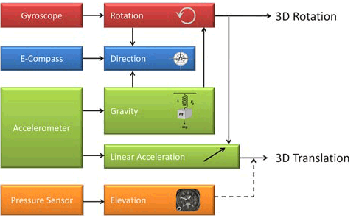
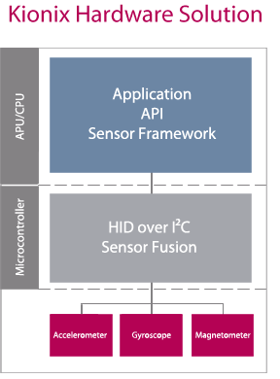
Sensor Fusion

Slide 7
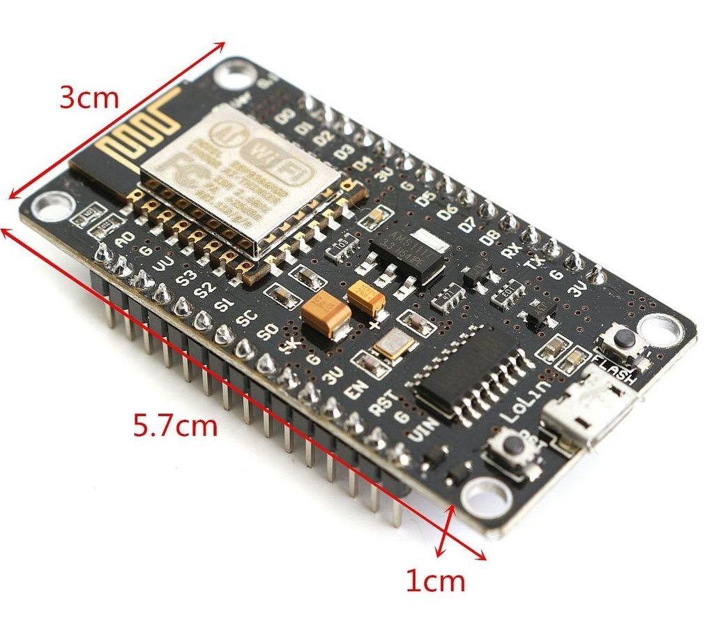
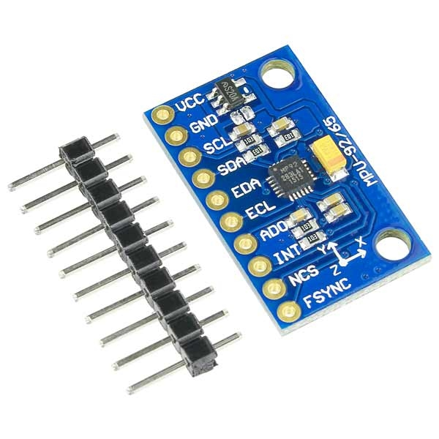
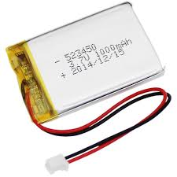
Hardware
MPU9250
Nodemcu ESP8266
3.7V Lithium-Ion Battery

Slide 8
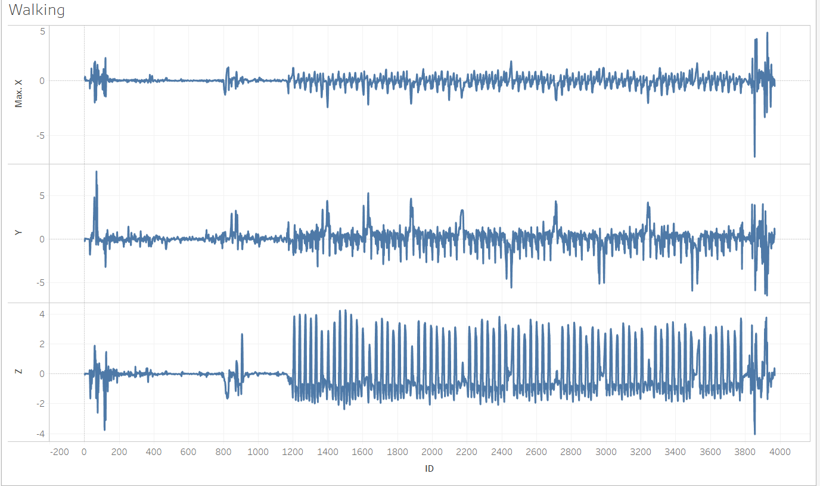
EDA

Slide 9
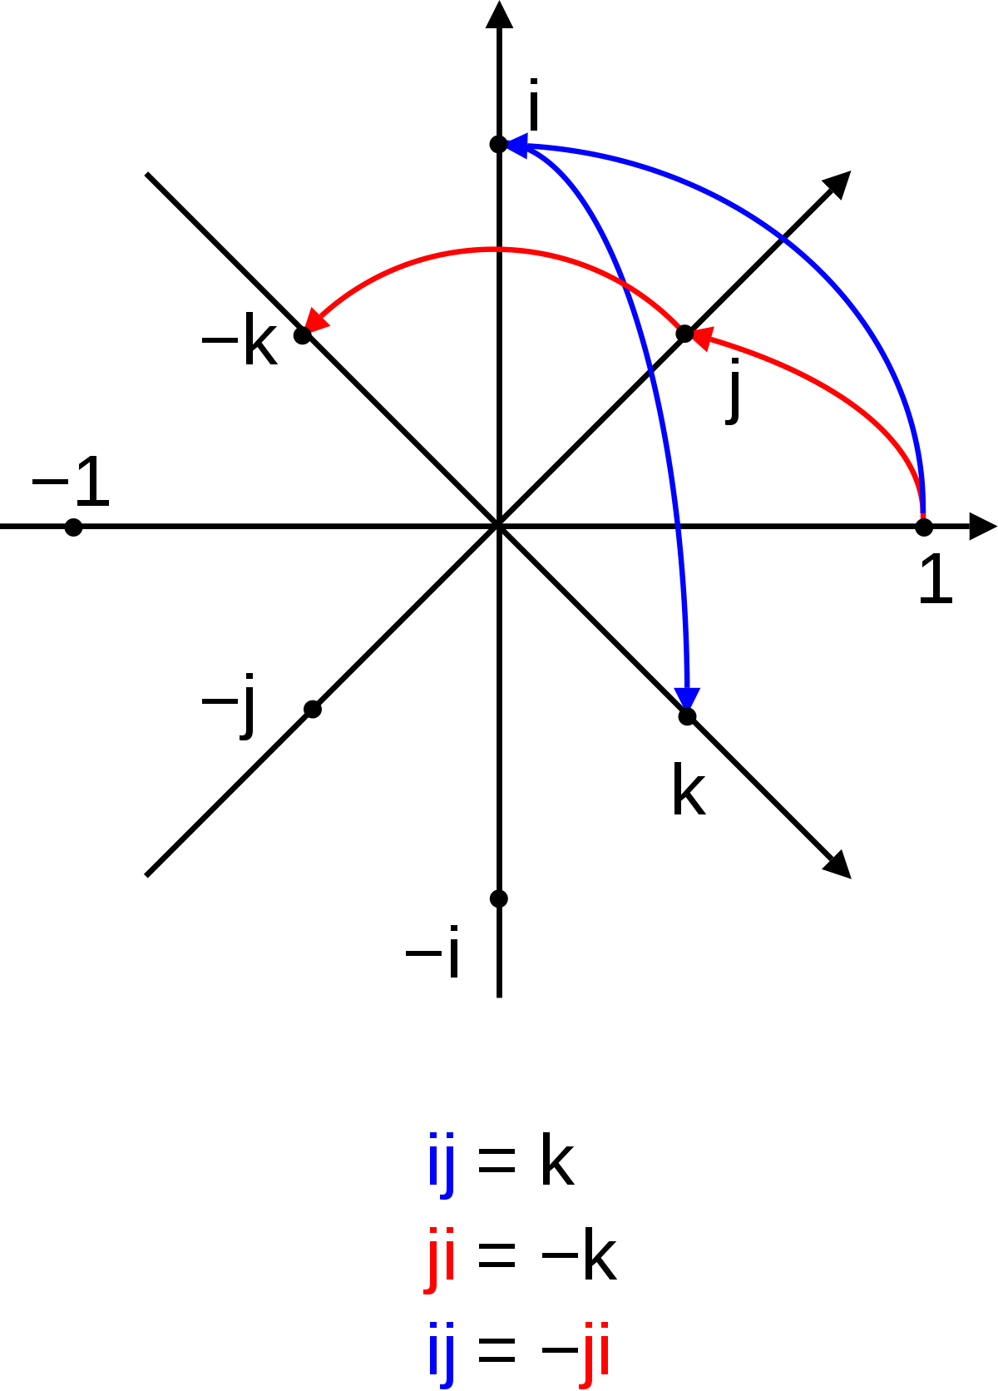
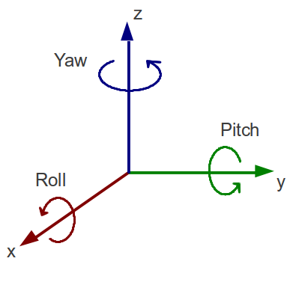
Data Gathering
No of Subjects Tested
5
1
No of Data Points
90 k
2
Duration of Data Gathered
45 Mins
3
No of
Activities
5
4
No of Sensors Features
18
5
No of Engineered Features
14
6
Quaternion
Yaw-Pitch-Roll

Slide 10
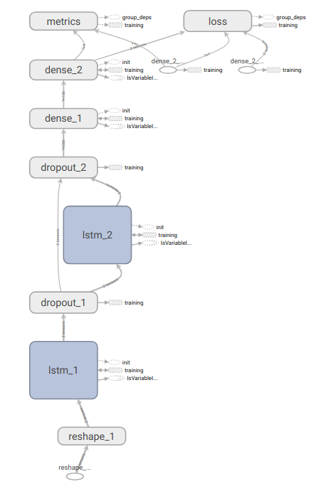

Model Building
LSTM Based RNN approach
Our Model

Slide 11
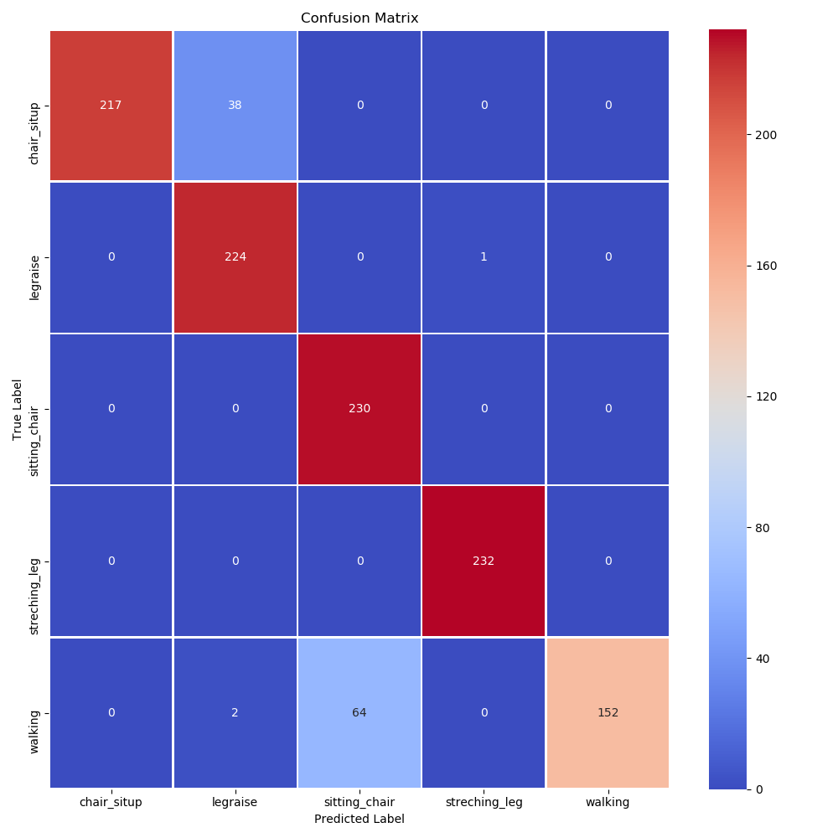
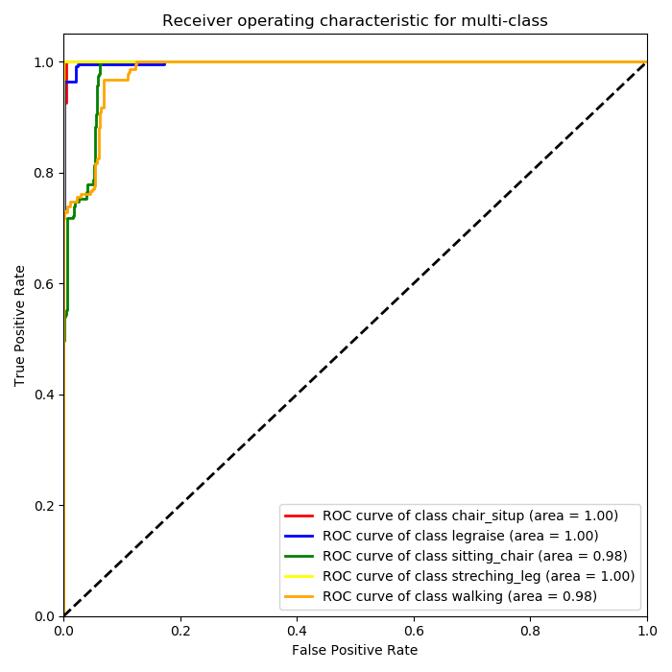
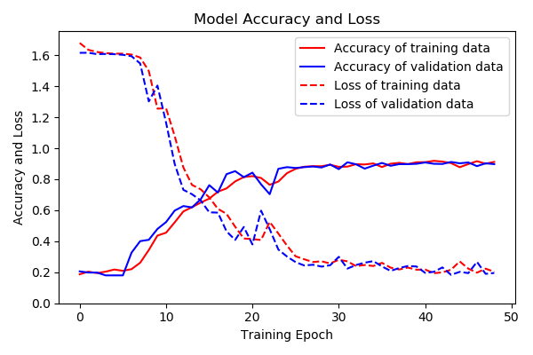
Model Evaluation

Slide 12
Reference
AHRS algorithm
‘DCM filter‘
http://ieeexplore.ieee.org/document/5695918/
http://ieeexplore.ieee.org/document/4913055/
12

Slide 13
THANK YOU

